Slide 1
Understanding Altitude

Slide 2
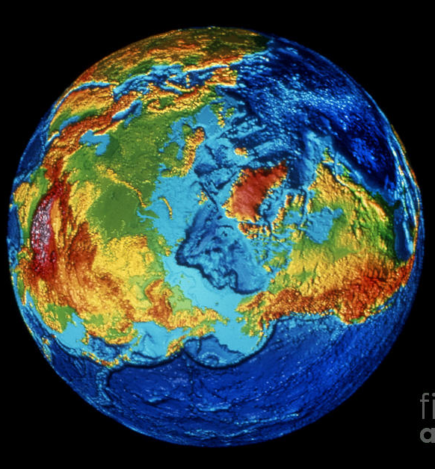
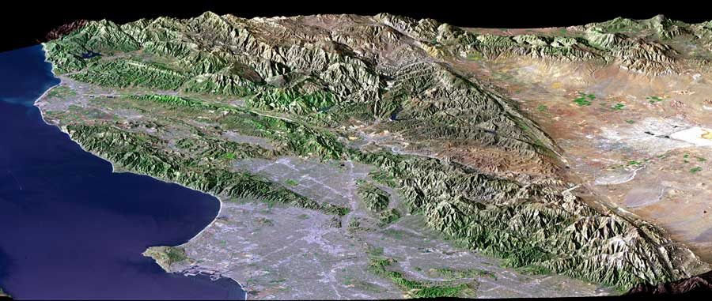
Topography:
General shape of the earth

Slide 3
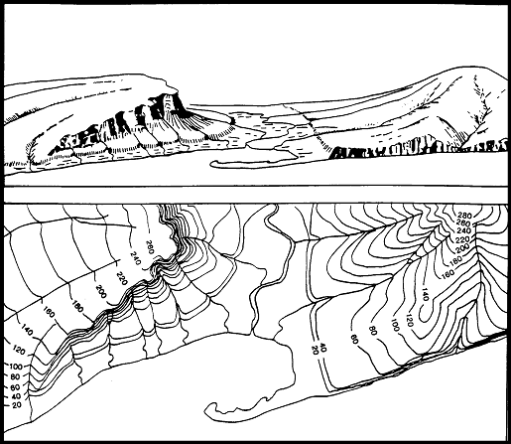
Topographic Maps:
Show the shape of the ground
Contain isolines called contour lines
https://www.youtube.com/watch?v=K-UXrpAjyl0

Slide 4
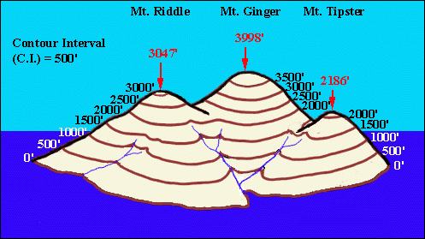
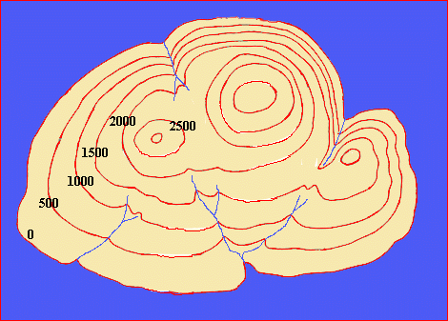
“Real World”
Contour Map

Slide 5
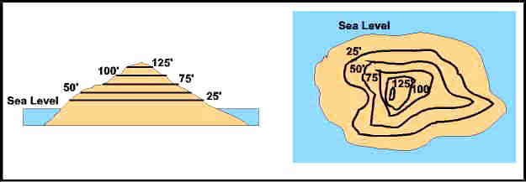
Contour line
Represent changes in elevation
Each contour line connects points of equal elevation

Slide 6
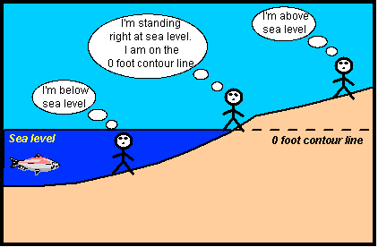
Altitude:
The elevation of a point, usually above sea level
Sea level is equal to zero

