Slide 1
Separation of Matter Notes
EQ: What are the different methods of physical separation?

Slide 2
Matter Flowchart

Slide 3
A. Separating Heterogeneous Mixtures
Based on differences in the size or density of the pure substances making up the mixture
Decanting
Filtering
Centrifuge
Physical Sorting
Magnet

Slide 4
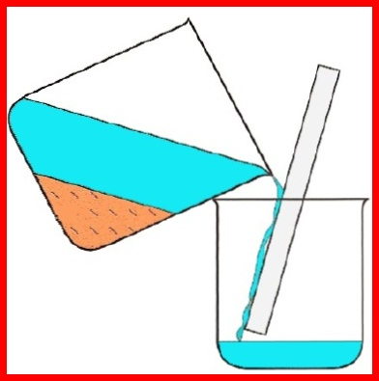
A. Separating Heterogeneous Mixtures
Decanting: pouring off the top layer of liquid (removes liquids from solids or liquids with different densities)

Slide 5
People decant older wines because they produce a lot of sediment as they age.

Slide 6
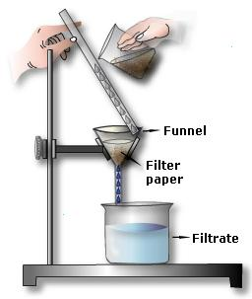
A. Separating Heterogeneous Mixtures
Filtering: Running a mixture of solid and liquid through filter paper. The undissolved solid is remains on top of the filter paper. Dissolved solid (solute) will run through the filter paper.

Slide 7
A. Separating Heterogeneous Mixtures
Centrifuge: Separation of solids and liquids or liquids with different densities using a machine that spins the densest substance to the bottom

Slide 8
Centrifuge Experiment
https://www.youtube.com/watch?v=8HQWJPFHBic

Slide 9
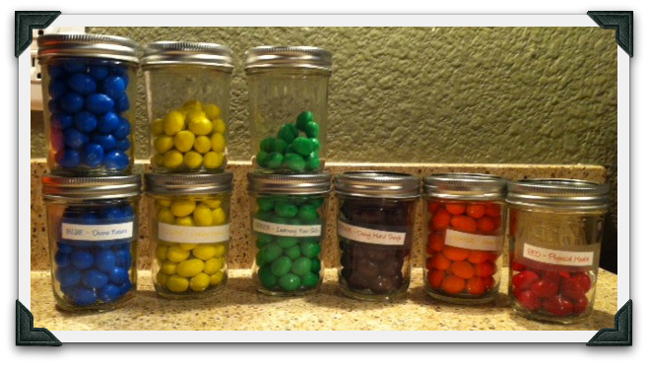
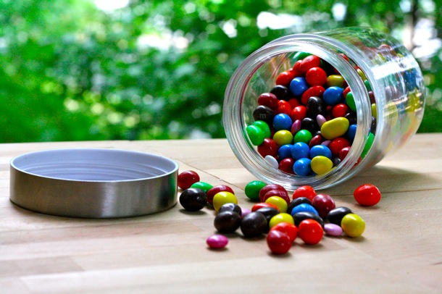
A. Separating Heterogeneous Mixtures
Physical Sorting: Separation of large solids (ex: sorting colors of M & M’s from a bag)

Slide 10
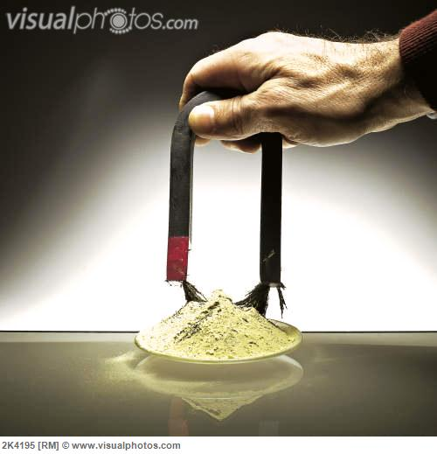
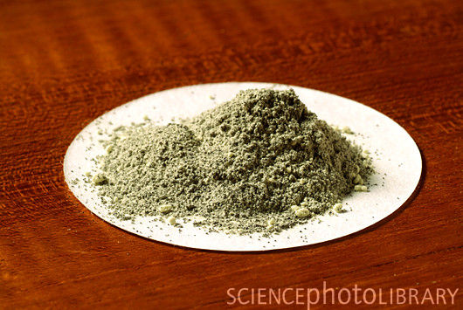
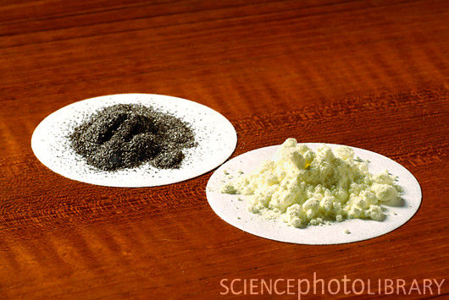
A. Separating Heterogeneous Mixtures
Magnet: Used to separate magnetic substances (like iron) from non-magnetic substances (like sulfur or sand)

Slide 11
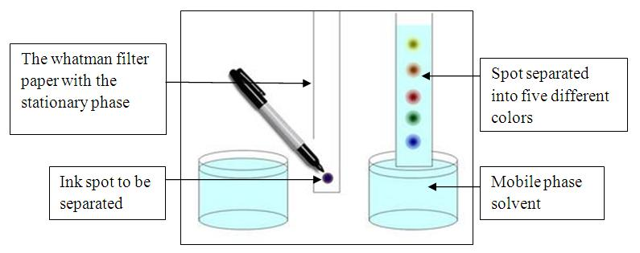
B. Separating Homogeneous Mixtures (solutions)
Chromatography – involves the sample being dissolved in a particular solvent called mobile phase (gas or liquid).

Slide 12
B. Separating Homogeneous Mixtures (solutions)
The mobile phase is then passed through another phase called stationary phase (solid packed in a glass plate or a piece of chromatography paper).

Slide 13
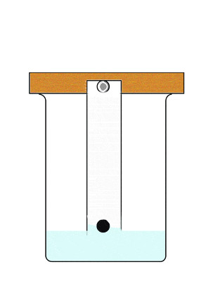
B. Separating Homogeneous Mixtures (solutions)
The various components of the mixture travel at different rates, causing them to separate.

Slide 14
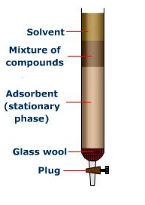
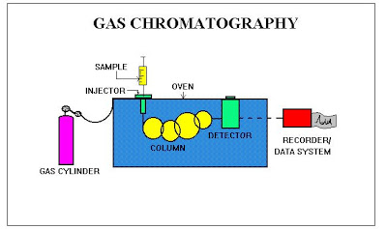
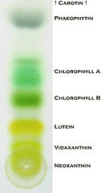
B. Separating Homogeneous Mixtures (solutions)
Types: column, paper, and gas chromatography.

Slide 15
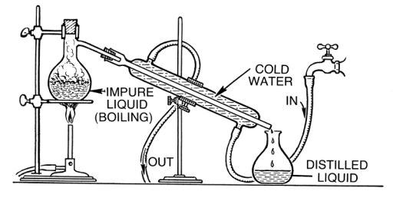
B. Separating Homogeneous Mixtures (solutions)
Distillation: used to separate a mixture of liquids based on boiling point. The liquid with the lowest boiling point evaporates first, runs through the condensing tube, and is then collected (distilled liquid).

Slide 16
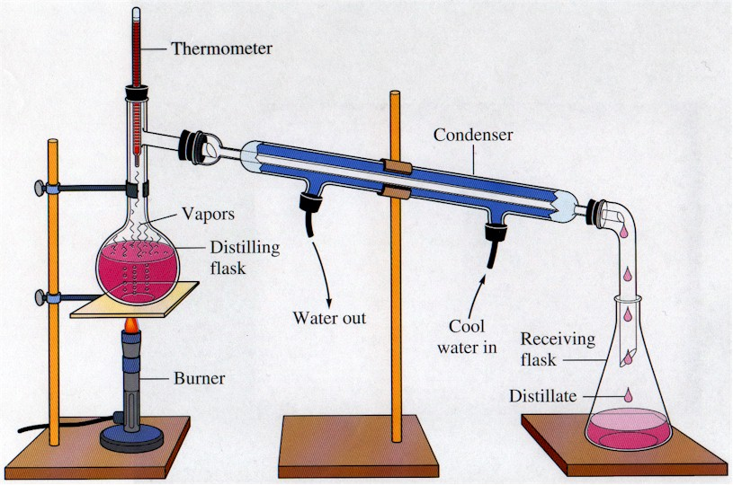

Slide 17
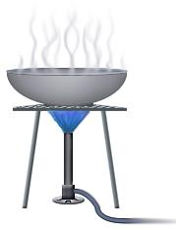
B. Separating Homogeneous Mixtures (solutions)
Evaporation (crystallization): used to separate solutions. The solid solute (dissolved substance) is left behind as the solvent/liquid (usually water) evaporates away

Slide 18
